Slide 1
Three Types of GoF Patterns
Creational patterns:
  Deal with initializing and configuring objects
Structural patterns:
  Composition of classes or objects
  Decouple interface and implementation of classes
Behavioral patterns:
  Deal with dynamic interactions among societies of objects
  How they distribute responsibility

Slide 2
Adapter pattern
Problem: How to resolve incompatible interfaces or provide a stable interface to similar components with different interfaces?
Solution: Convert original interface component into another one through an intermediate adapter.

Slide 3
NextGenPos
    Suppots third party services
        Tax calculators
        Credit authorization services
        Inventory systems
        Accounting systems

Slide 4
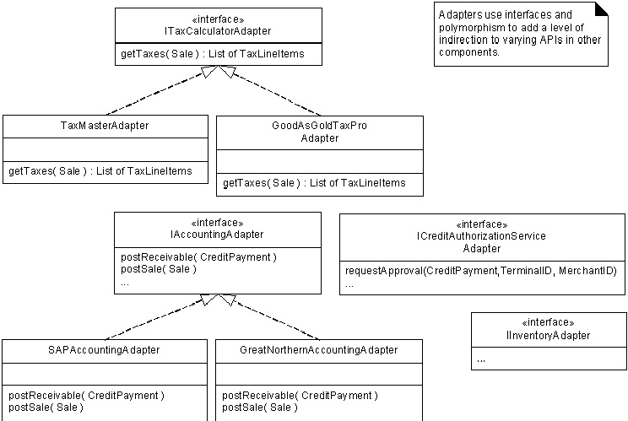
POS example: Instantiate adapters for external services

Slide 5
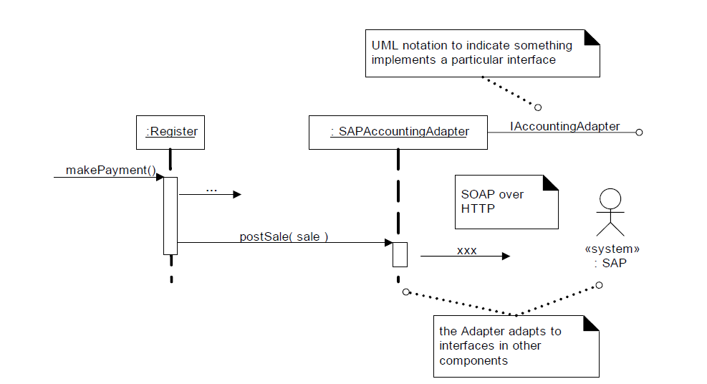

Slide 6
The Adapter pattern is used so that two unrelated interfaces can work together. The joining between them is called an Adapter. This is something like we convert interface of one class into interface expected by the client. We do that using an Adapter.

Slide 7
Benefits of Adapter pattern
Reduces coupling to implementation specific details
Polymorphism and Indirection reveals essential behavior provided
Including name of design pattern in new class (e.g., TaxMasterAdapter) in class diagrams and code communicates to other developers in terms of known design patterns
It allows two or more previously incompatible objects to interact.
It allows reusability of existing functionality.

Slide 8
Usage of Adapter pattern:
It is used:
When an object needs to utilize an existing class with an incompatible interface.
When you want to create a reusable class that cooperates with classes which don't have compatible interfaces.

Slide 9
BRIDEGE PATTERN
IT separates out the interface from its implementation.
The bridge pattern is a design pattern used in software engineering which is meant to
"decouple an abstraction from its implementation so that the two can vary independently".

Slide 10
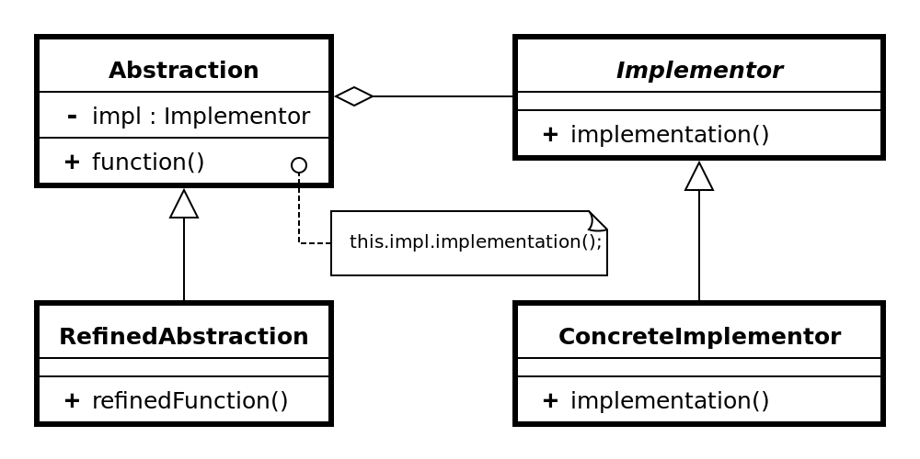

Slide 11
Abstraction (abstract class)
defines the abstract interface
maintains the Implementor reference.
RefinedAbstraction (normal class)
extends the interface defined by Abstraction
Implementor (interface)
defines the interface for implementation classes
ConcreteImplementor (normal class)
implements the Implementor interface

Slide 12
It involves an interface which acts as bridge .
This bridge makes the functionality of concrete classes independent from interface implementor classes
The bridge uses encapsulation, aggregation, and can use inheritance to separate responsibilities into different classes

Slide 13
FACADE
A facade is an object that provides a simplified interface to a larger body of code

Slide 14
The Facade design pattern is often used when a system is very complex or difficult to understand because the system has a large number of interdependent classes or its source code is unavailable.
This pattern hides the complexities of the larger system and provides a simpler interface to the client.
It typically involves a single wrapper class which contains a set of members required by client. These members access the system on behalf of the facade client and hide the implementation details.

Slide 15


Slide 16
Simple Factory pattern
Context/Problem
  Who should be responsible for creating objects when there are special considerations, such as complex logic,a desire to separate the creation responsibilities for better cohesion, and so forth
Solution
  Create a Pure Fabrication to handle the creation

Slide 17


Slide 18
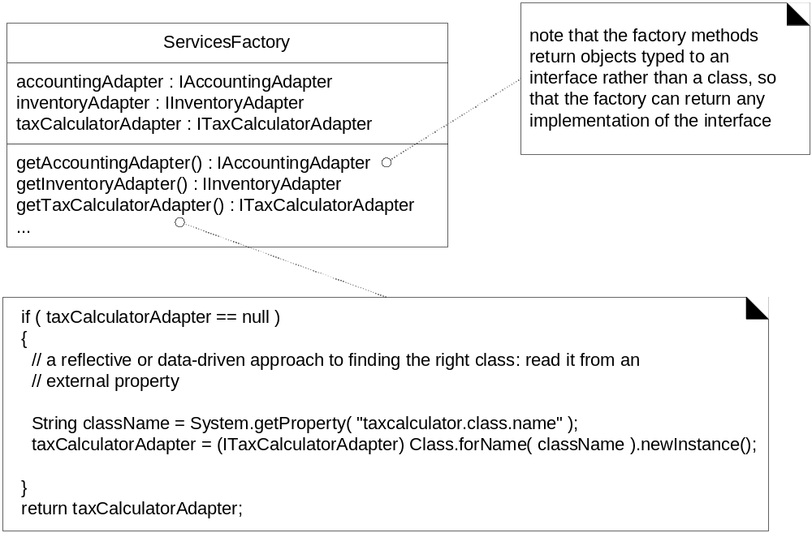
Factory can create different objects from a file
Figure 26.5

Slide 19
Advantages of Factory Objects?
Separates responsibility of complex creation into cohesive helper classes
Hides complex creation logic, such as initialization from a file
Handles memory management strategies,
such or recycling or caching

Slide 20
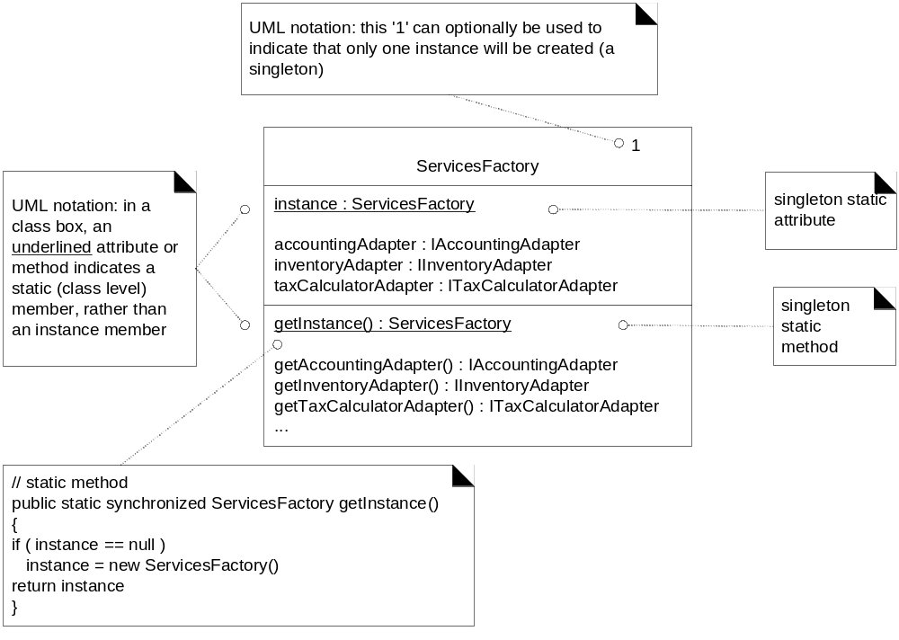
Use Singleton to create a Factory
Figure 26.6

Slide 21
public class MazeGame {
public MazeGame() {
Room room1 = makeRoom();
Room room2 = makeRoom();
room1.connect(room2);
this.addRoom(room1);
this.addRoom(room2);
}
protected Room makeRoom()
{
return new OrdinaryRoom(); } }
:
public class MagicMazeGame extends MazeGame
{ @Override protected Room makeRoom()
{ return new MagicRoom(); } }

Slide 22
Singleton
restricts the instantiation of a class to one object

Slide 23
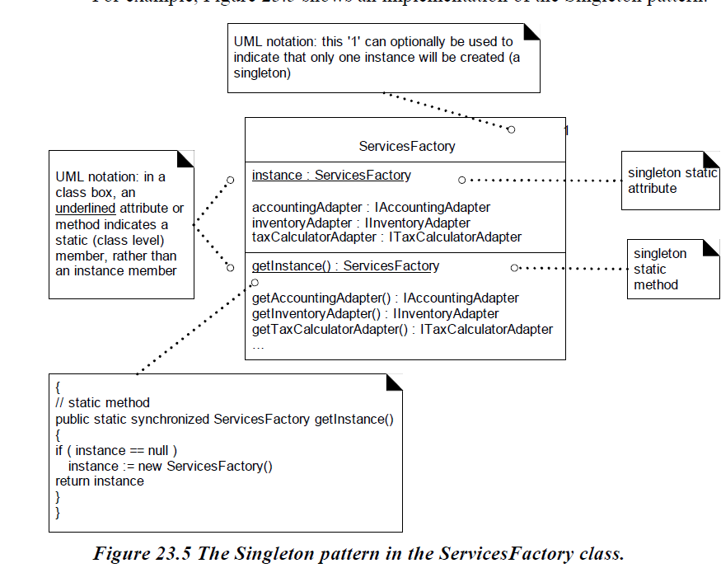

Slide 24
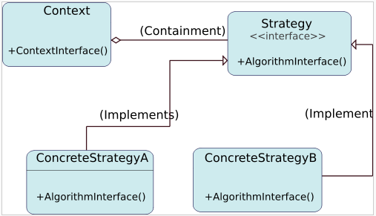
Strategy design pattern
Problem: How to design a family of algorithms or policies that are essentially the same but vary in details?
Solution: "Define a family of algorithms, encapsulate each one, and make them interchangeable." [Gamma, p315]
Use abstraction and polymorphism to show high level algorithm and hide varying implementation details

Slide 25
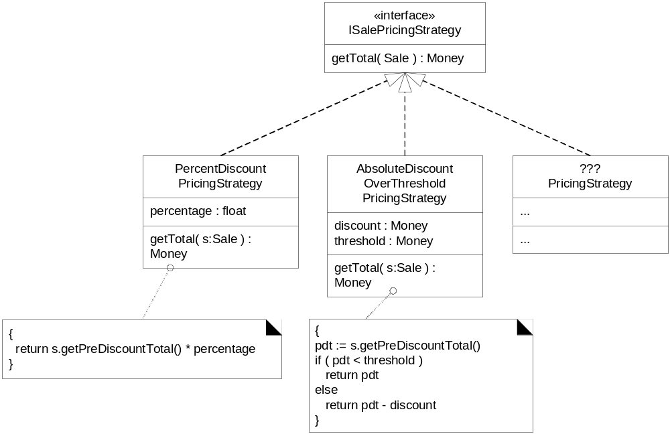
Multiple SalePricingStrategy classes with polymorphic getTotal method
Figure 26.9

Slide 26
Observer pattern
Intent:
  Define a one-to-many dependency between objects
  so that when one object changes state, all its dependents are notified and updated automatically
Used in Model-View-Controller framework
  Model is problem domain
  View is windowing system
  Controller is mouse/keyboard control
How can Observer pattern be used in other applications?
JDK’s Abstract Window Toolkit (listeners)
Java’s Thread monitors, notify(), etc.

Slide 27
The observer pattern is a software design pattern in which an object, called the subject, maintains a list of its dependents, called observers, and notifies them automatically of any state changes, usually by calling one of their methods. It is mainly used to implement distributed event handling systems.

Slide 28
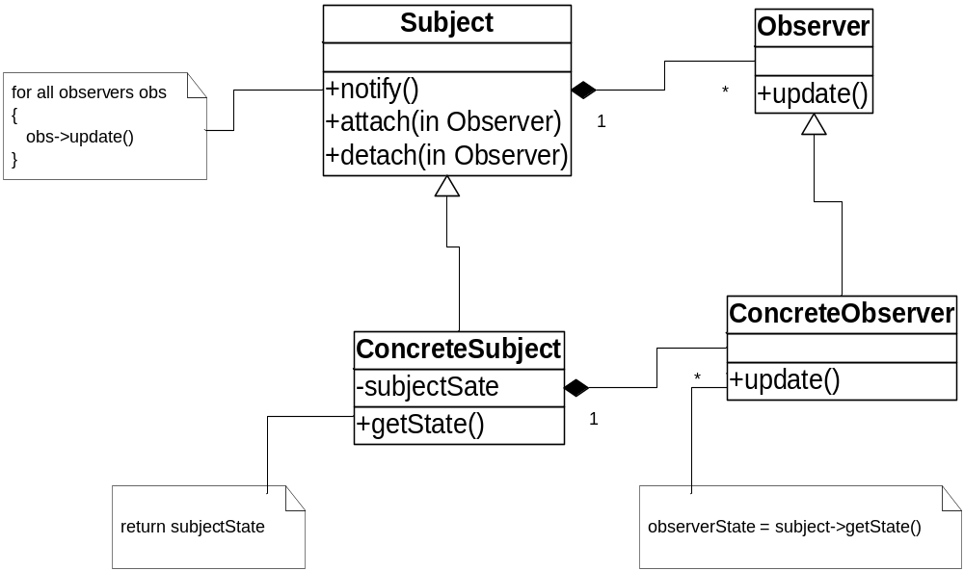
Structure of Observer Pattern

Slide 29
Subject
  Has a list of observers
  Interface for attaching/detaching an observer
Observer
  An updating interface for objects that gets notified of changes in a subject
  Concrete Subject
  stores state of interest to observers
  Sends notification when state changes
  Concrete Observer
  Implements updating interface.

Slide 30
Benefits of Design Patterns
Design patterns enable large-scale reuse of software architectures and also help document systems
Patterns explicitly capture expert knowledge and design tradeoffs and make it more widely available
Patterns help improve developer communication
Pattern names form a common vocabulary

